Slide 1

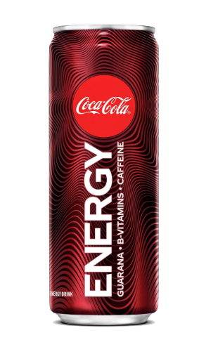
Coca-Cola Energy Creative Campaign
Starla Birnbaum, Kevin Mitchell, Chelsea Stern

Slide 2

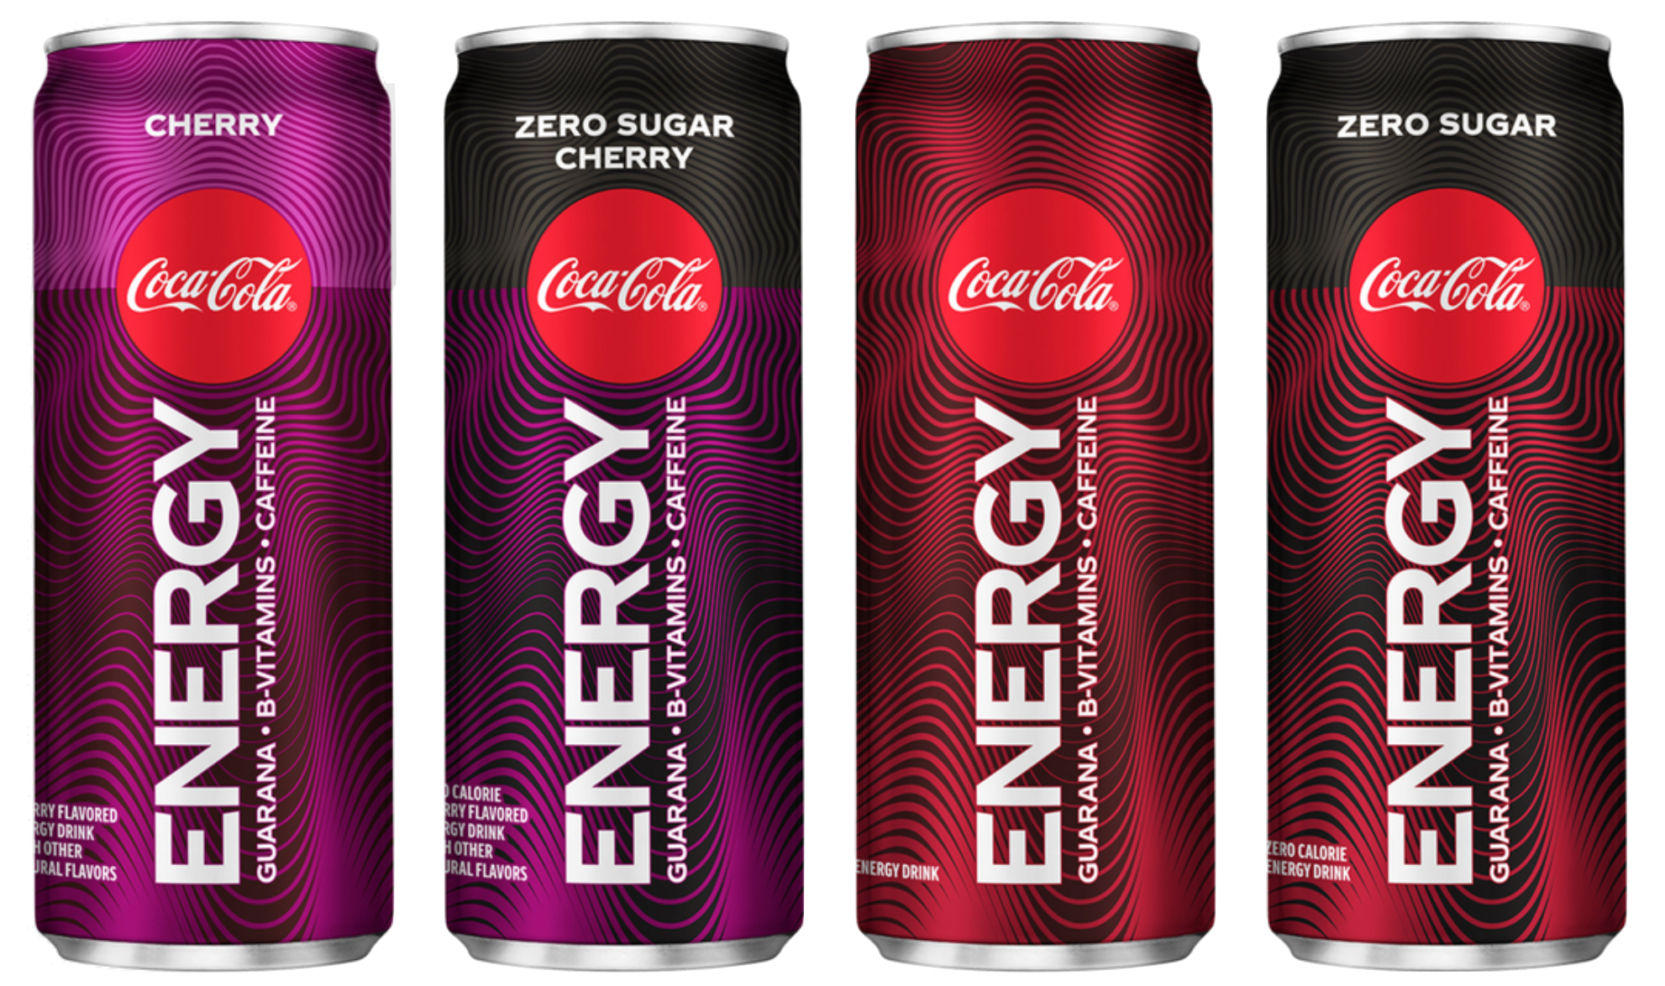
Campaign Objective
Proposition work
Our story
Position Coca-Cola Energy as a versatile, “daily life” energy drink allowing consumers to simply drink it as they would a soda throughout their day.
Alleviate the guilt associated with other similar intense, sugar-packed energy products on the market with Coca-Cola Energy.
Target Persona
Everyday Evan
18 to 49-year-olds, predominantly male, urban regionally-based consumers of habit multiple times per week, likes to make plans to socialize after work or class, seeks external source of motivation (casual soda drinkers over energy drink fanatics)
Mindset shift
Current Mindset: Guilt is associated with soda due to negative health benefits. Lack of functionality in soda leads to a lack of daily consumption. Drink soda for taste and/or with a meal, but not for any important reason outside of these.
Desired Mindset: Engage consumers so their awareness recognizes Coca-Cola Energy as a drink that can either be a tasty, vitamin-filled replacement for other sources or as an additional everyday beverage. The approach must be friendly and personable, not as intimidating as competitors.

Slide 3

Concept
Color Palette
Complemented by gray and white (sometimes black)
Needs, Challenges, Motivators
Seeking a boost to feel good doing everyday activities
Making it through the day with sustained energy
Thriving off of social interaction but can’t always match others’ energy
HEX #722040
HEX #d3394c
HEX #af2d46
HEX #6a1c48
HEX #8b2444
Tagline
“Take charge of today.”
Charge is used both to take control of the day and fuel yourself with energy that “charges” you up
Typefaces
HEADER - BEBAS NEUE
Body - Quicksand
Call to Action
You can “take charge” of your day with the purchase and consumption help of Coca-Cola energy
Keywords
Charge, fuel, positivity, boost, energy, today, everyday

Slide 4
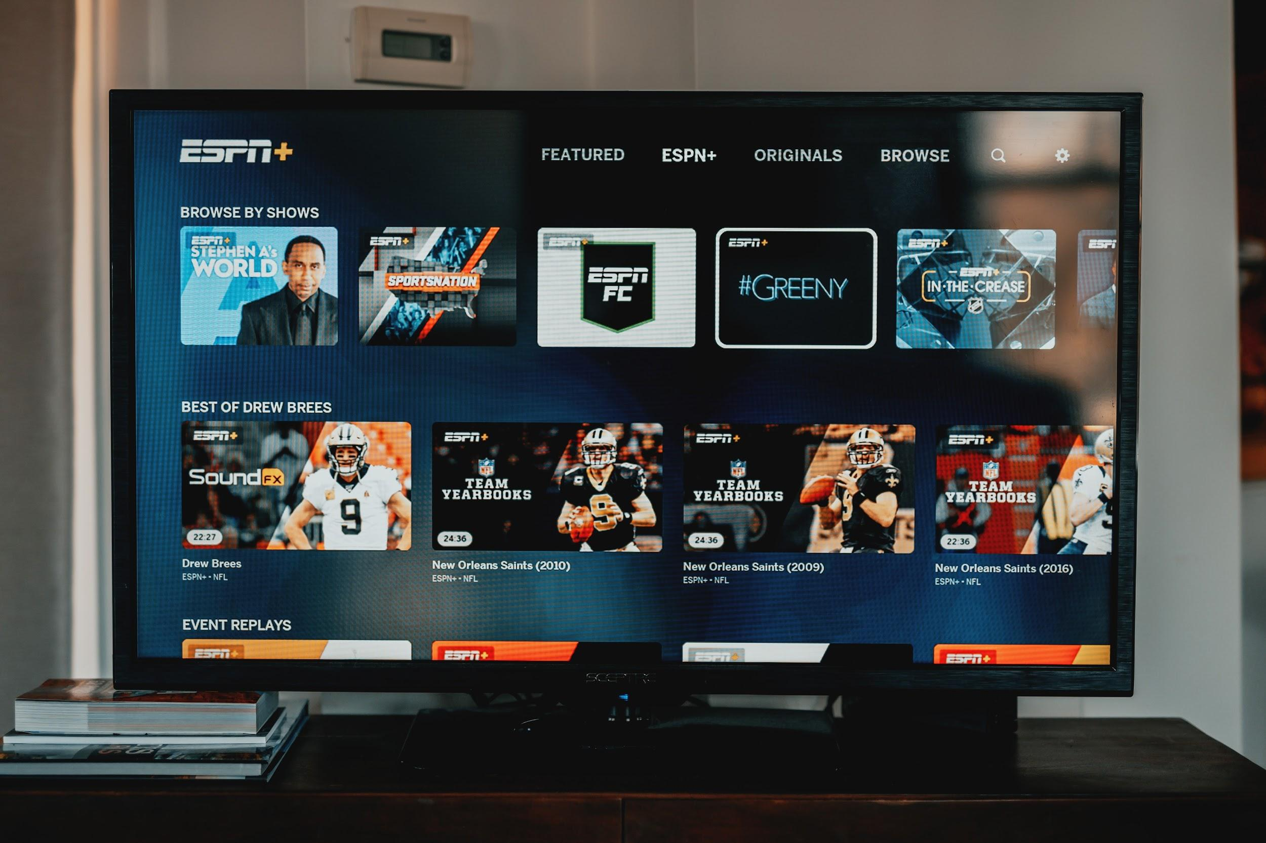

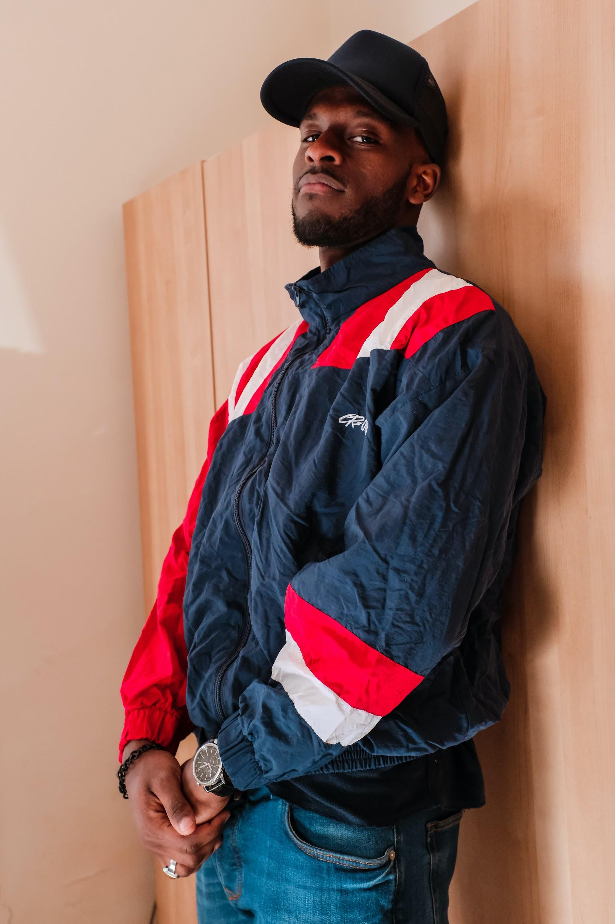



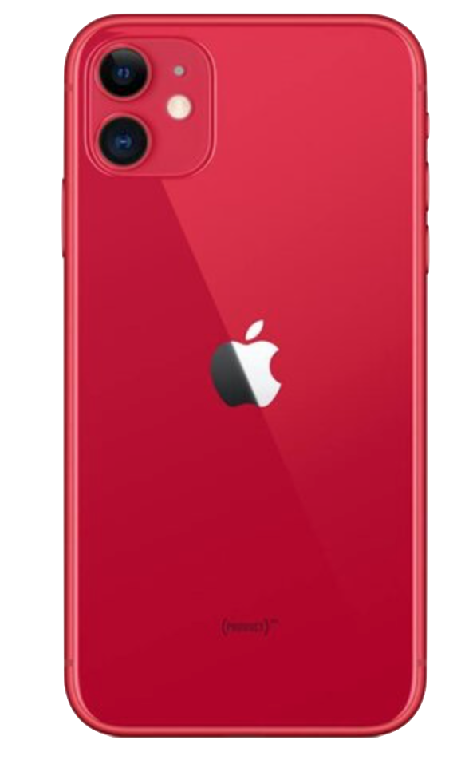
Concept Visuals

Slide 5
TV
Direction and Strategic Execution:
30-second ad: The same Coca-Cola Energy can is pictured in different settings (ex. On the table at a restaurant, in the locker room at a gym, on someone’s desk, etc.) to show product versatility, at the end it ends up in the hand of Everyday Evan and he opens it.
Placement:
Hulu streaming
ESPN during game time commercial breaks
CBS prime time

Slide 6
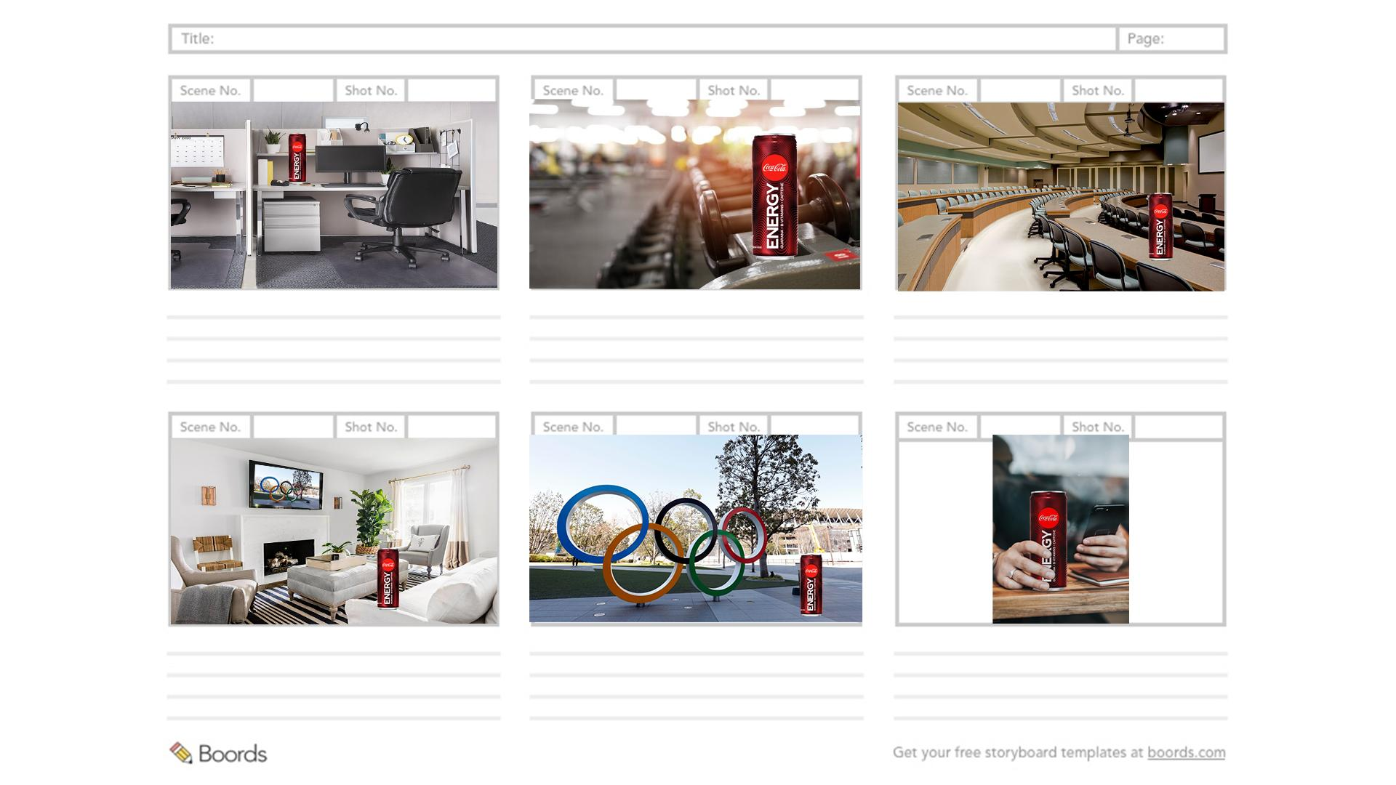
TV Commercial Storyboard
Coca-Cola Energy in an office
Coca-Cola Energy in a gym
Coca-Cola Energy in a lecture hall
Coca-Cola Energy in a living room, Olympics on TV
Zooms into TV, Coca-Cola Energy at the Olympics
Everyday Evan cracks the Coca-Cola Energy

Slide 7
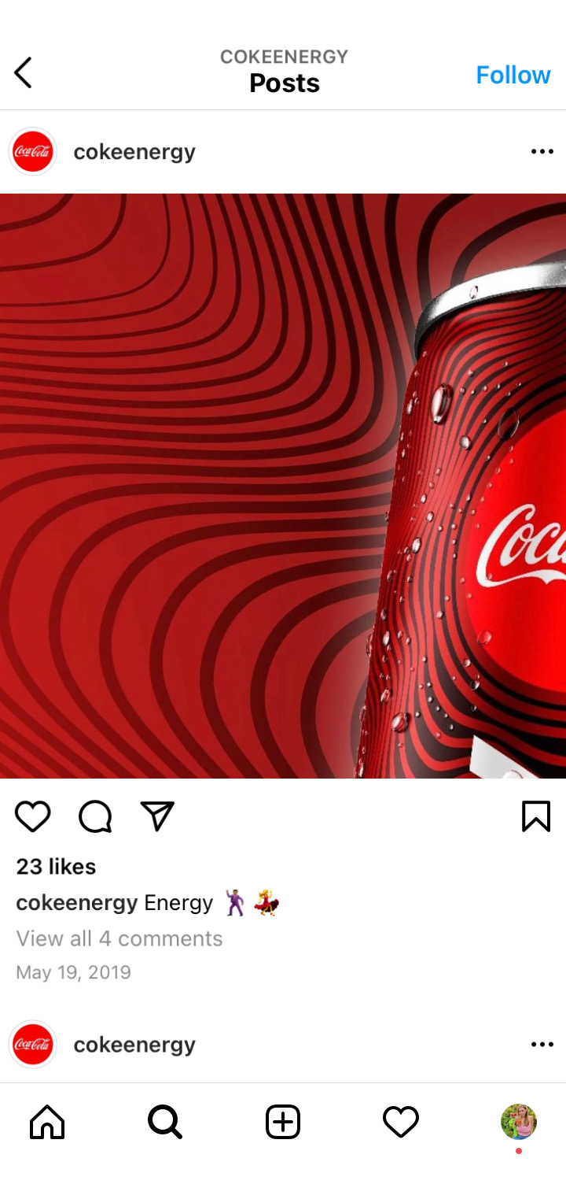
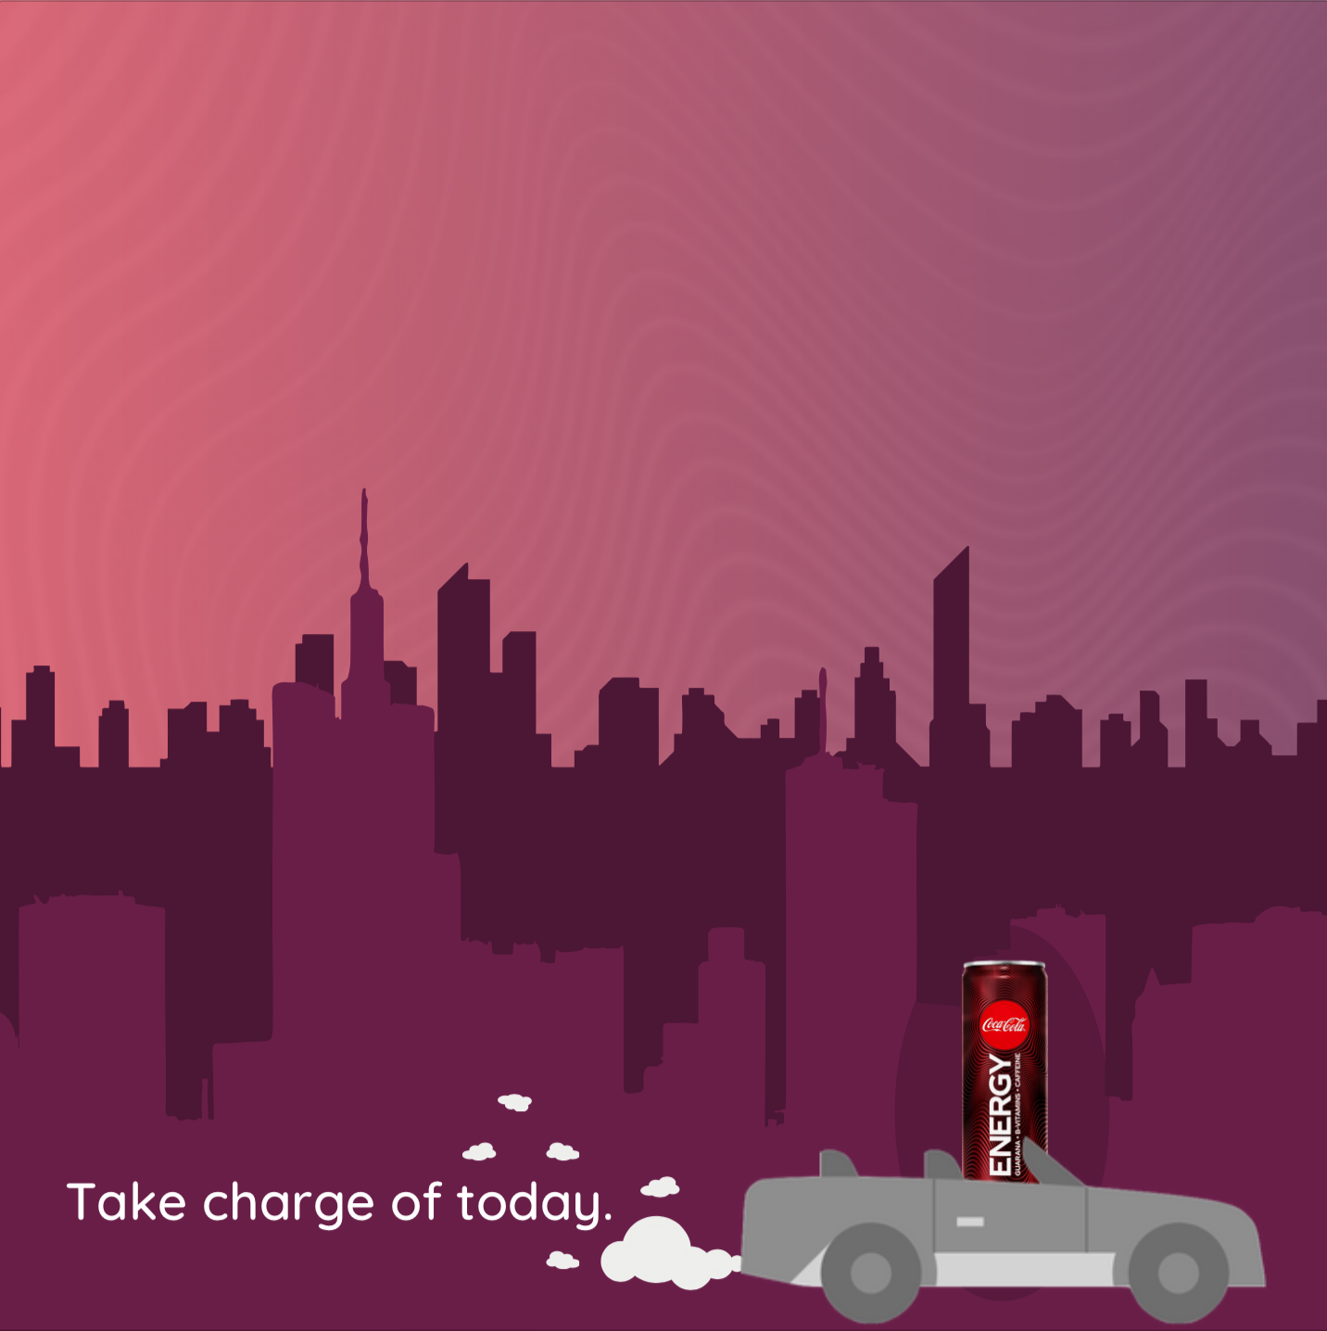
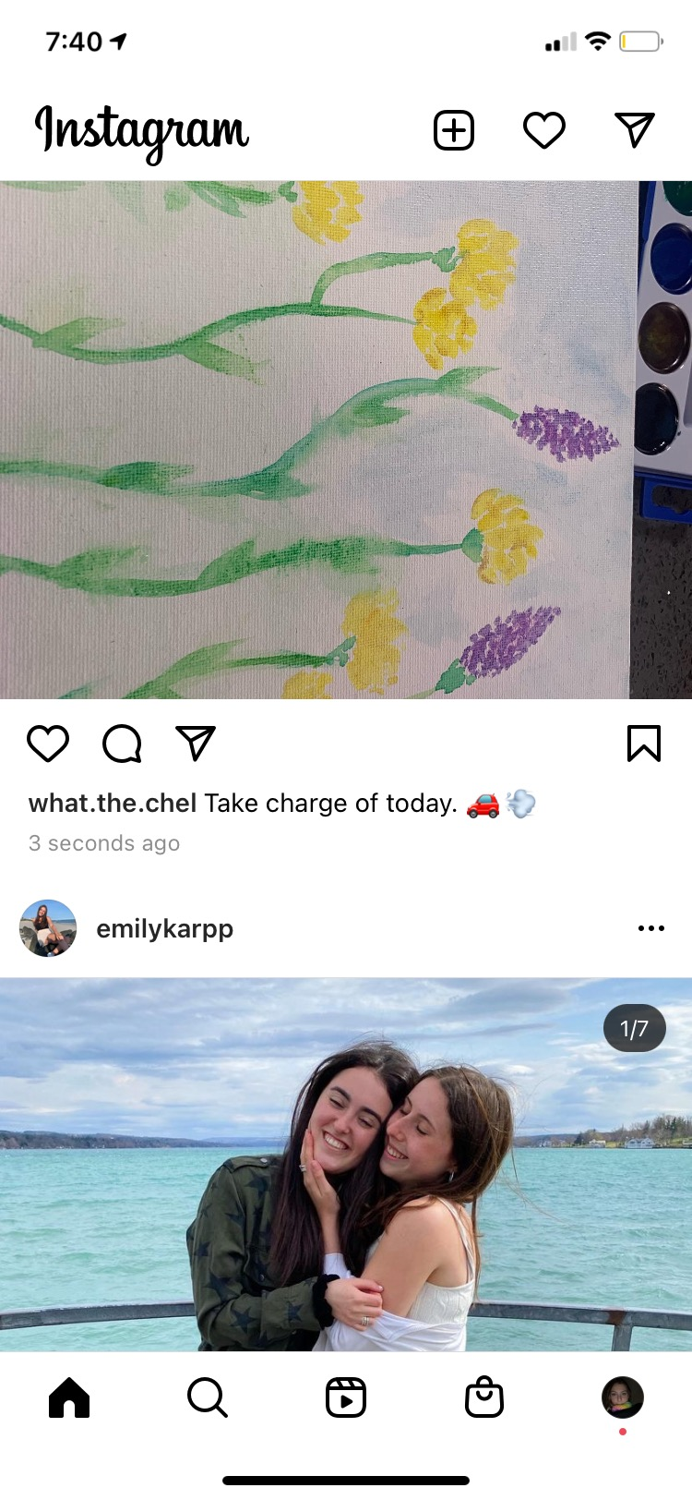
DIGITAL/Social
Platform: Instagram, Facebook (include hyperlink to website to drive traffic)
Content type: Graphic (still)
Direction and Strategic Execution
Minimalistic portrayal of Coca-Cola Energy can with reds and purples as background accent colors, conveys energy and stimulation in a mundane, day-to-day, on-the-move type of setting
The light part of the sky represents the day’s struggles that the target persona already made it through, and the dark part is what the energizing boost of Coca-Cola energy will help push the person through

Slide 8
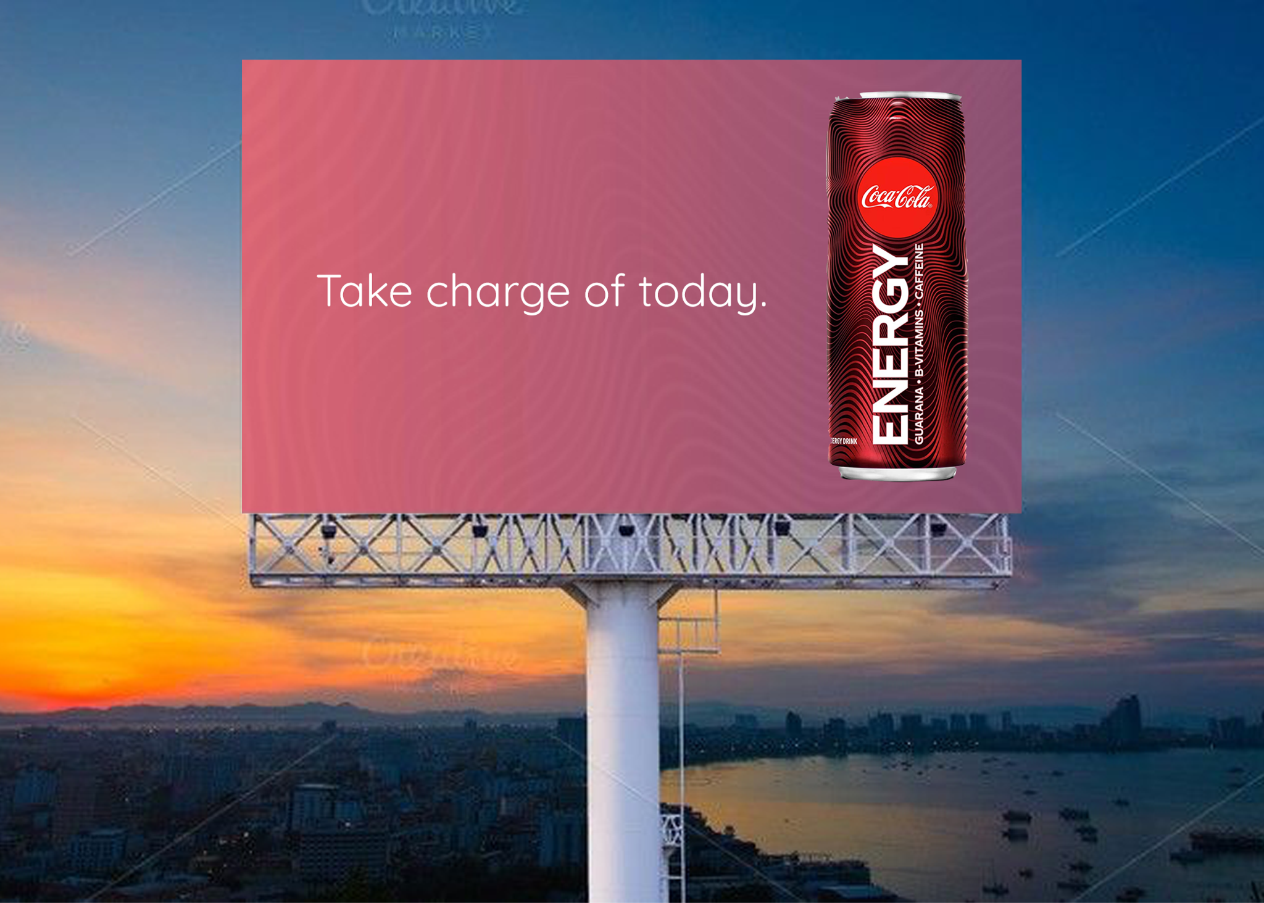
Outdoor
Platform: Billboard (on busy roads and highways)
Content type: Still
Direction and Strategic Execution
Continuing the minimalistic interpretation of the brand with the red and purple gradient
The product is big on the billboard so someone driving past can just be able to glance and know what is being advertised
Only the tagline on the billboard to keep to the minimalistic brand so it is not cluttered

Slide 9
Conclusion/Summary
Our advertising campaign emphasizes two major things: energy and versatility, both encompassed by one four word-tagline. Our tagline, “take charge of today,” makes it clear that Coca-Cola Energy will provide the boost you need for your day, everyday. Our approach is to position the energy drink as a casual beverage, like a Coca-Cola soda, that you can drink every day without the guilt of a more intense energy drink. Coca-Cola Energy takes on a revamped, positive style for stimulating energy intake.
In addition, the TV ad shows Coca-Cola Energy in a variety of settings, showcasing that Coca-Cola Energy is a drink you can consume whenever, wherever. Our target persona, Everyday Evan, can best be reached through digital social media outlets as well as sports and comedy focused TV networks. As we appeal to an urban-centric demographic, billboards will be an additional way to catch the eye of the Coca-Cola Energy target market with bold minimalism. The creative styling of this campaign also utilizes a purplish-pink color as a background to create both a bold and reassuring feeling; it’s comforting yet strikingly positive.

Slide 10
Appendix: 50 Taglines
Take charge of today
Fuel up
Feel your best
Live for today
Make today yours
Take back today
Everyday energy
Feel good fuel
Recharge today
For everyday use
Versatile energy
Energy’s switchblade
How everyone energizes
Pit stop fuel
Load the tank
Booted up
Guilt free energy
Feel good without feeling bad
Enhance your daily life
The energy you need, the taste you love
Time to refuel
Let’s recharge
Get back to you
Get back to what you love
Gametime all the time
Go time all the time
For the grinders
Getting it done all day
All day everyday
That’s what I like
Feel your best to be your best
The modern morning kick
All energy all day
Energy always
Fuel yourself to feel yourself
Everyday kind of fun
Feel good every day
Live re-energized
Power up
Workin’ it out
Grind time
Energize today
Energy to make you your best
Don’t waste today
Make every day a good day
Give yourself a good day
The ‘always’ energy
Enhance today
Energize your life
Energy for everyone

